Slide 1
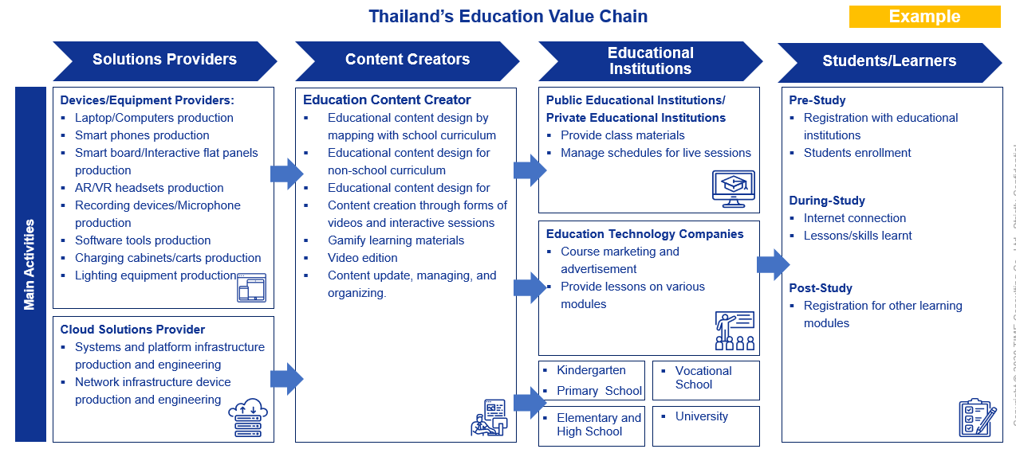
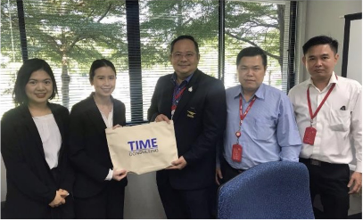
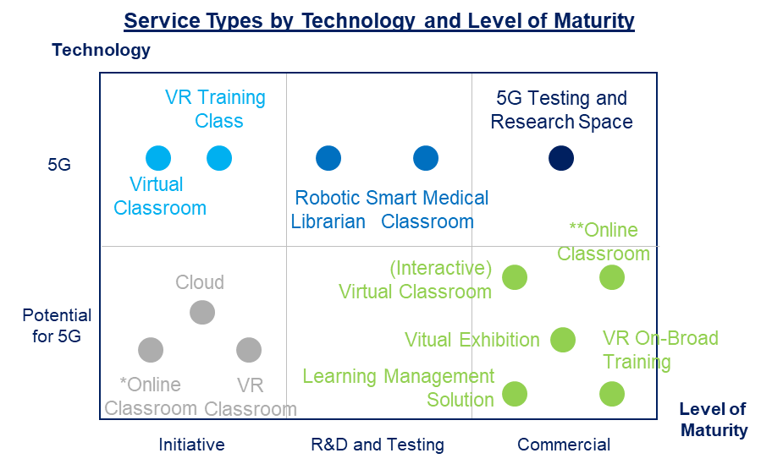
Government and Industry Initiatives on 5G in Hongkong
GOVERMENT
INDUSTRY
Health Care
Media Entertainment
1
1
Telemedicine
Personal Health Systems
Cloud Gaming
Augmented Reality / Virtual Reality (AR / VR)
Manufacturing
Financial Services
2
2
Manufacturing Automation
Remote Robotic Control
Loan Monitoring and Collateral Management
Micro-Payments on Assets
Public Safety
Retail
3
3
Surveillance (Smart Cities)
Surveillance cameras
Infrastructure Management and Maintenance
Geo-Targeted Advertisement Precision
Shoppable Videos
Public Transport
Agriculture
4
4
High-Mobility Connectivity
Passenger Distribution
Organizational Needs
Organizatonal Structure
Members’Attributes towards Technology
Decision Making Practice
Connected Machinery
Automated farming equipment
Farming Drones for Monitoring
5G Virtual Classroom
Example
Example: In-depth interviews with Agriculture and Cooperative from previous 5G projects in 2019

